Slide 1
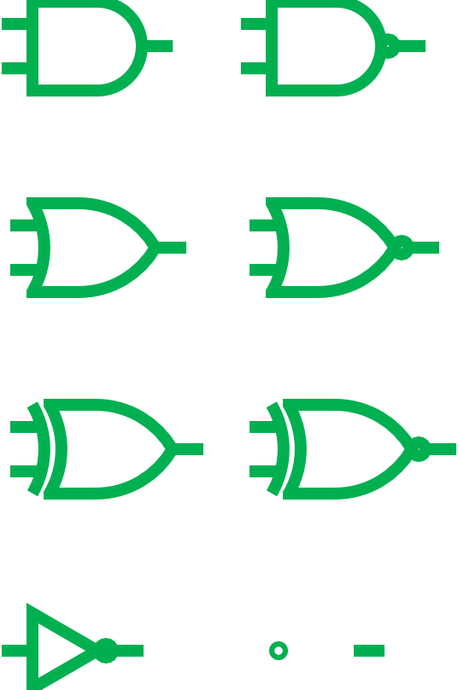








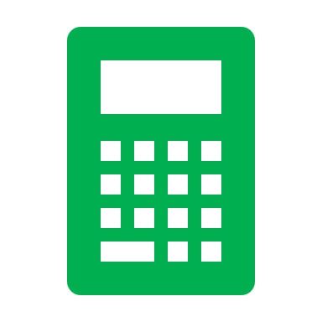






ECE213: Digital Electronics
Ajmer Singh
9988921373
ajmer.17381@lpu.co.in

Slide 2

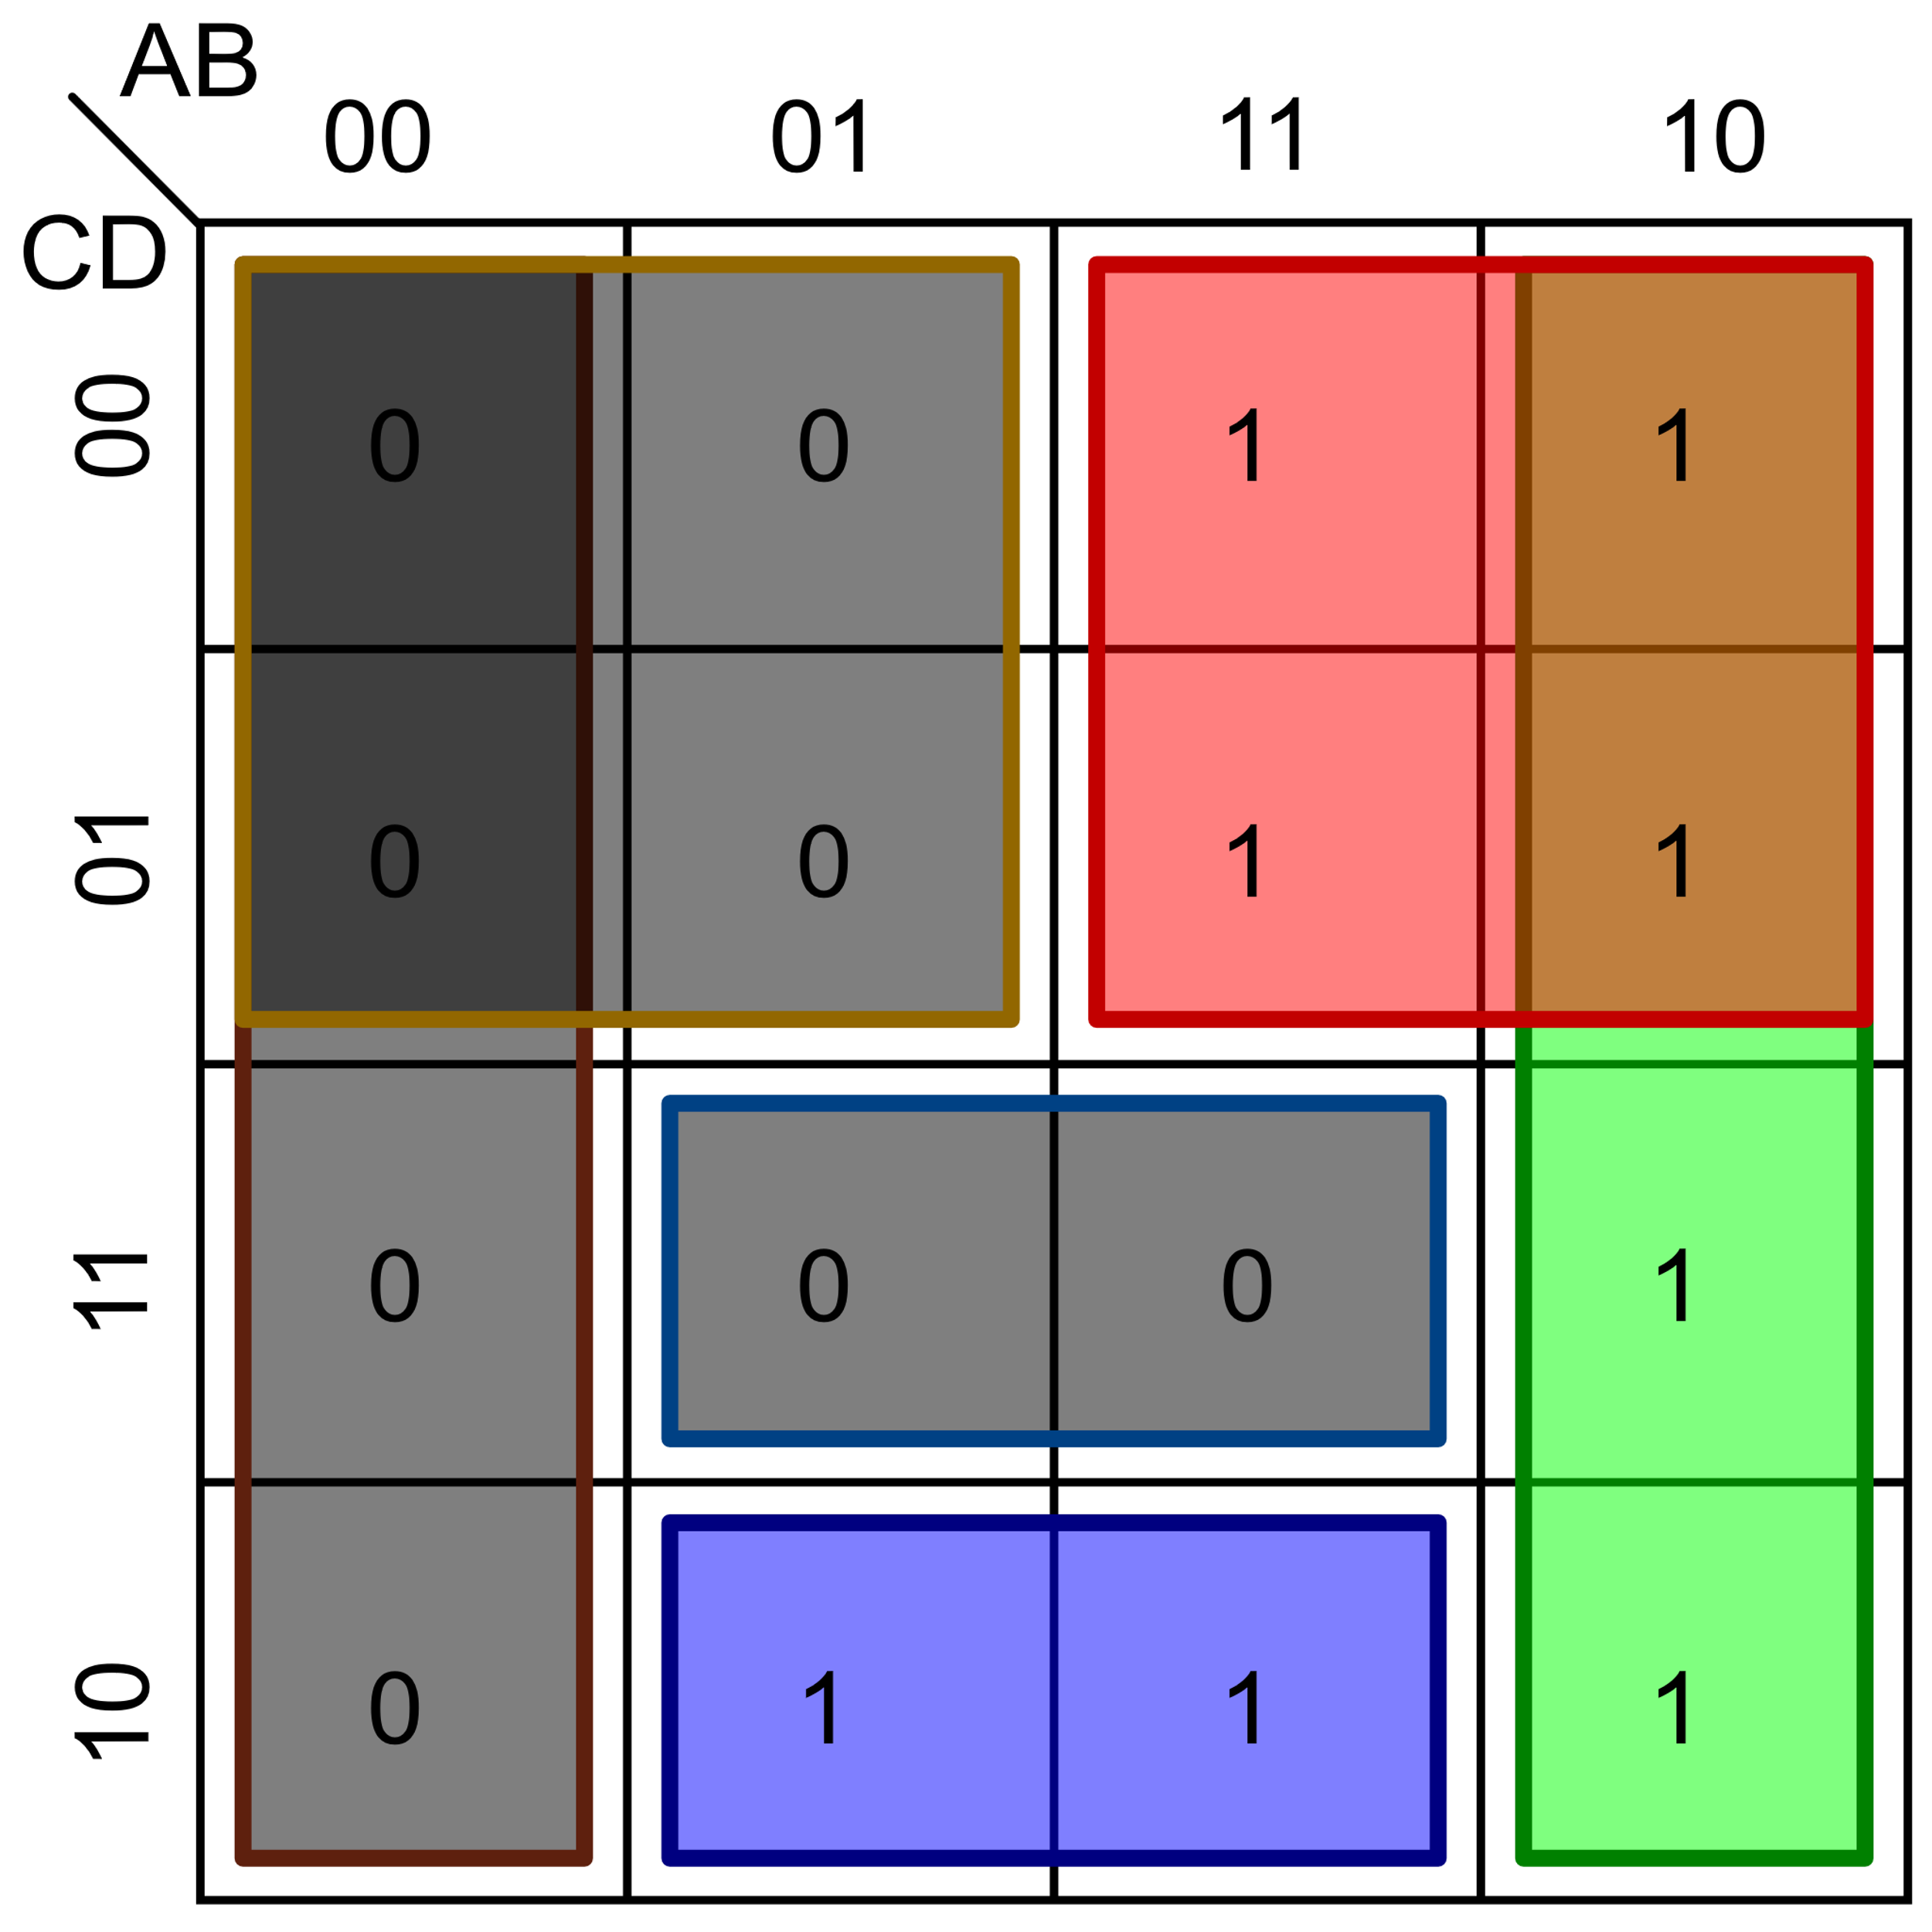
The Course Contents
Unit II
Combinational Logic System : Truth table, Basic logic operation, Boolean Algebra, Basic postulates, Standard representation of logic functions -SOP forms, Simplification of switching functions - K-map, Synthesis of combinational logic circuits, Logic gates, Fundamental theorems of Boolean algebra, Standard representation of logic functions POS forms

Slide 3
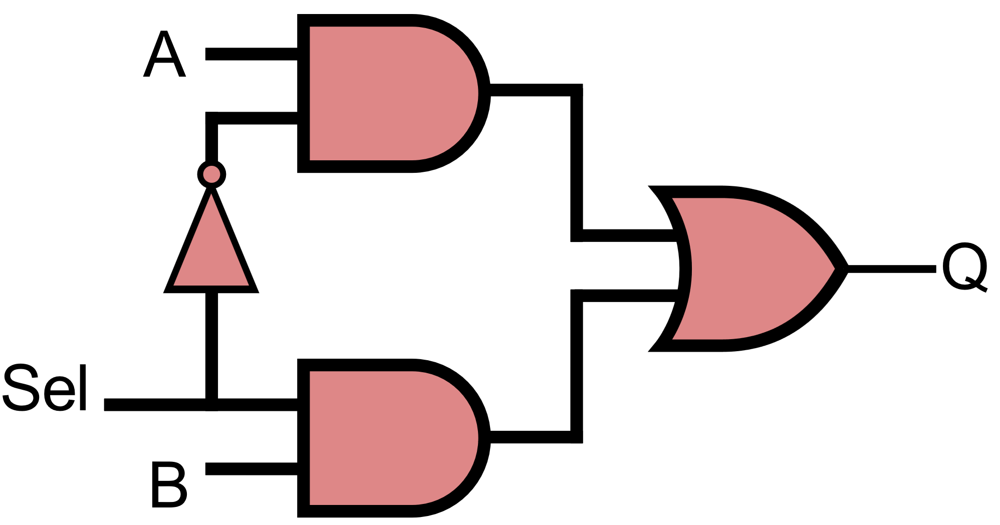
The Course Contents
Unit III
Introduction to Combinational Logic Circuits : Adders, Subtractors, Comparators, Multiplexers and Demultiplexers, Decoders, Encoders, Parity circuits Introduction to Logic Families : Introduction to different logic families, Structure and operations of TTL, MOS and CMOS logic families

Slide 4
Combinational Logic System
Simplification of switching functions - Karnaugh-map
Notes:
http://www.ee.surrey.ac.uk/Projects/Labview/minimisation/karrules.html

Slide 5
Combinational Logic System
Simplification of switching functions - K-map

Slide 6
Combinational Logic System
Simplification of switching functions - K-map

Slide 7
Combinational Logic System
Simplification of switching functions - K-map

Slide 8
Combinational Logic System
Simplification of switching functions - K-map

Slide 9
Combinational Logic System
Simplification of switching functions - K-map

